Slide 1
Clustering
Weimao Ke
<wk@drexel.edu>
College of Information Science and Technology
The iSchool at Drexel, Drexel University

Slide 2
Outline
Introduction to clustering
Clustering for IR
Document Clustering and Term Clustering
Two clustering algorithms
Hierarchical Agglomerative Clustering (HAC, with simulations)
K-means clustering (with simulations)
Clustering Evaluation

Slide 3
Introduction to Clustering

Slide 4
What is clustering?
Ch. 16
Clustering: the process of grouping a set of objects into classes of similar objects
Documents within a cluster should be similar.
Documents from different clusters should be dissimilar.
The commonest form of unsupervised learning
Unsupervised learning = learning from raw data, as opposed to supervised data where a classification of examples is given
A common and important task that finds many applications in IR and other places

Slide 5
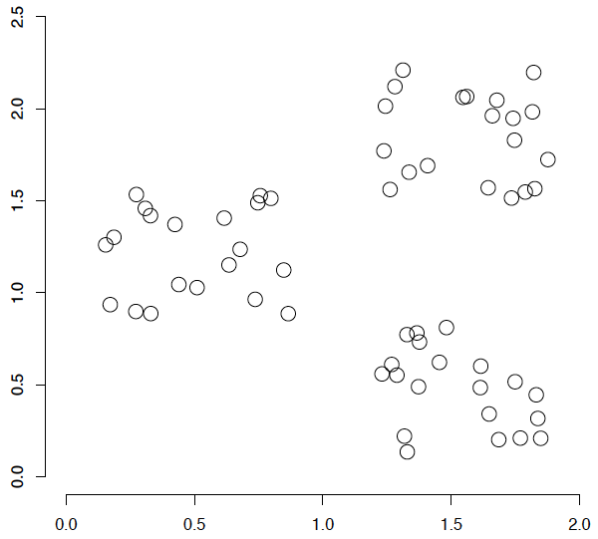
A data set with clear cluster structure
Ch. 16
How would you design an algorithm for finding the three clusters in this case?

Slide 6
Yahoo! Hierarchy isn’t clustering but is the kind of output you want from clustering
www.yahoo.com/Science
… (30)
agriculture
biology
physics
CS
space
...
...
...
...
...
dairy
crops
botany
cell
AI
courses
craft
magnetism
HCI
missions
forestry
agronomy
evolution
relativity
Notes:
Final data set:
Yahoo Science hierarchy, consisting of text of web pages pointed to by Yahoo, gathered summer of 1997.
264 classes, only sample shown here.

Slide 7
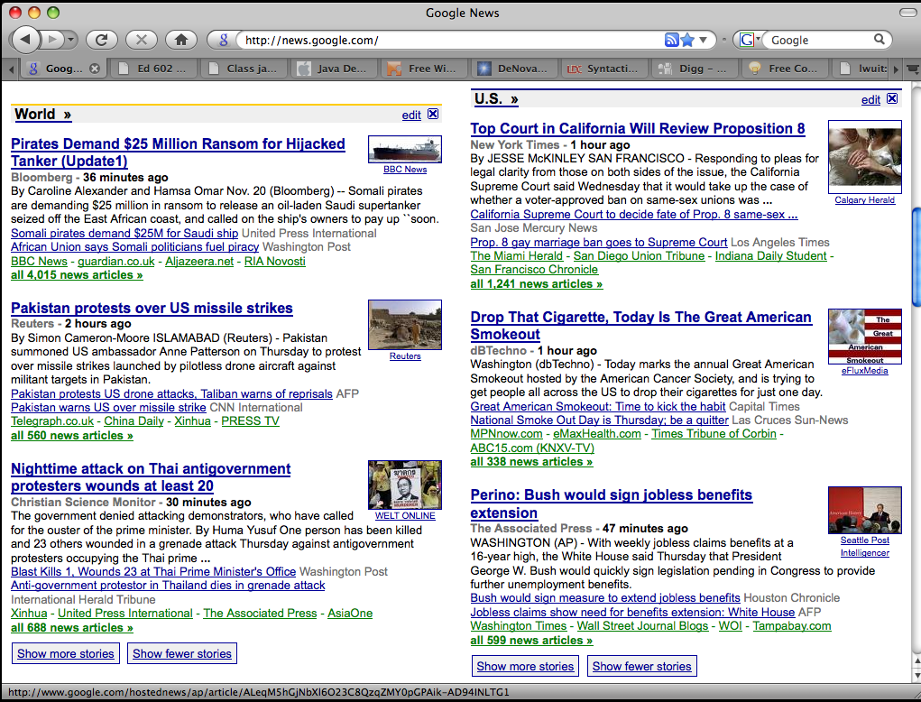
Google News: automatic clustering gives an effective news presentation metaphor

Slide 8
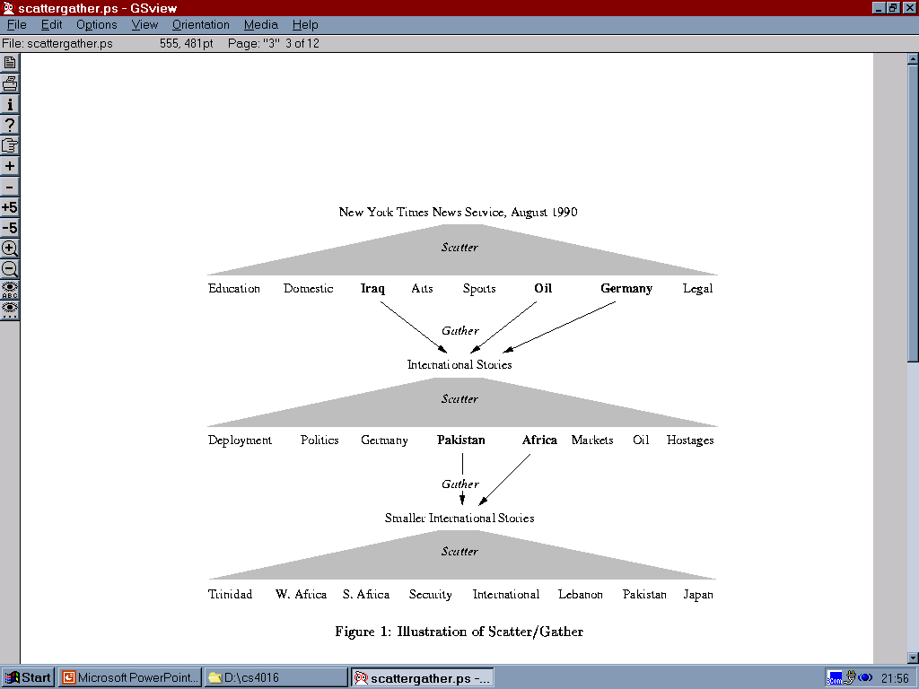
Scatter/Gather: Cutting, Karger, and Pedersen
Sec. 16.1

Slide 9
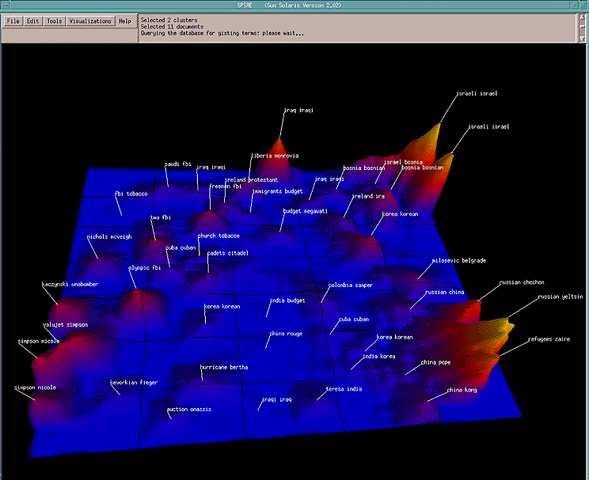
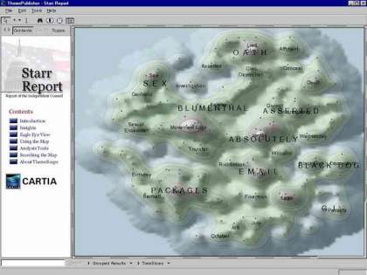
For visualizing a document collection and its themes
Wise et al, “Visualizing the non-visual” PNNL
ThemeScapes, Cartia
[Mountain height = cluster size]

Slide 10
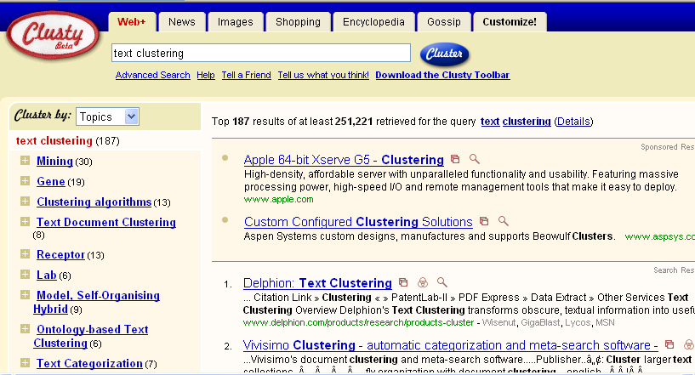
For better navigation of search results
Sec. 16.1
For grouping search results thematically
clusty.com / Vivisimo

Slide 11
Clustering in IR

Slide 12
Clustering, classification & ranking
Clustering: Given a set of docs (entities), group them into clusters based on their contents.
Classification: Given a set of topics, plus a new doc D, decide which topic(s) D belongs to.
Ranking: Can we learn how to best order a set of documents, e.g., a set of search results

Slide 13
For improving search recall
Sec. 16.1
Cluster hypothesis - Documents in the same cluster behave similarly with respect to relevance to information needs
Therefore, to improve search recall:
Cluster docs in corpus a priori
When a query matches a doc D, also return other docs in the cluster containing D
Hope if we do this: The query “car” will also return docs containing automobile
Because clustering grouped together docs containing car with those containing automobile.
Why might this happen?

Slide 14
Issues for clustering
Sec. 16.2
Representation for clustering
Document representation
Vector space? Normalization?
Centroids aren’t length normalized
Need a notion of similarity/distance
How many clusters?
Fixed a priori?
Completely data driven?
Avoid “trivial” clusters - too large or small
If a cluster's too large, then for navigation purposes you've wasted an extra user click without whittling down the set of documents much.

Slide 15
Notion of similarity/distance
Ideal: semantic similarity.
Practical: term-statistical similarity
We will use cosine similarity.
Docs as vectors.
For many algorithms, easier to think in terms of a distance (rather than similarity) between docs.
We will mostly speak of Euclidean distance
But real implementations use cosine similarity

Slide 16
Clustering Algorithms
Flat algorithms
Usually start with a random (partial) partitioning
Refine it iteratively
K means clustering
Hierarchical algorithms
Bottom-up, agglomerative
(Top-down, divisive)

Slide 17
Hard vs. soft clustering
Hard clustering: Each document belongs to exactly one cluster
More common and easier to do
Soft clustering: A document can belong to more than one cluster.
Makes more sense for applications like creating browsable hierarchies
You may want to put a pair of sneakers in two clusters: (i) sports apparel and (ii) shoes
You can only do that with a soft clustering approach.
We won’t do soft clustering in this lecture

Slide 18
Partitioning Algorithms
Partitioning method: Construct a partition of n documents into a set of K clusters
Given: a set of documents and the number K
Find: a partition of K clusters that optimizes the chosen partitioning criterion
Effective heuristic methods: K-means

Slide 19
Document Clustering and Term Clustering

Slide 20
Clustering
Again, clustering is unsupervised learning
Derives patterns from data without known labels.
As opposed to categorization, or supervised learning, where labels are known.
How to do clustering for IR?
How do we group documents together?

Slide 21
Document clustering
We focus on document clustering
Use terms as vector values for each document
i.e., table rows on next slide
Calculate inter-document closeness/similarities
Group the documents
The same applies to term clustering
How do we group terms together?
Use documents as vector values for each term
i.e., table columns on next slide
Calculate inter-term similarities
Group the terms

Slide 22
Document Term Matrix
Terms
 | T1 | T2 | T3 | … | Tm
D1 | 1 | 0 | 1 | 0 | 1
D2 | 1 | 1 | 0 | 1 | 0
D3 | 0 | 1 | 1 | 0 | 1
… | 0 | 1 | 0 | 0 | 1
Dn | 1 | 1 | 0 | 1 | 0
Docs
Here is an example of document-term matrix using a Boolean (binary) representation.
But more often, term frequency or TF*IDF values are used instead.

Slide 23
Document Vector Space
To visualize documents as data points, assume we have only two indexing terms
Recall our discussions on vector space representation…
Documents can be placed as data points on the dimensional space, where each dimension/coordinate represents an index term.
Term 2
e.g., “Data”
(Y)
doc4
doc5
Document
doc6
doc2
doc1
doc3
Term 1, e.g., “Information” (X)

Slide 24
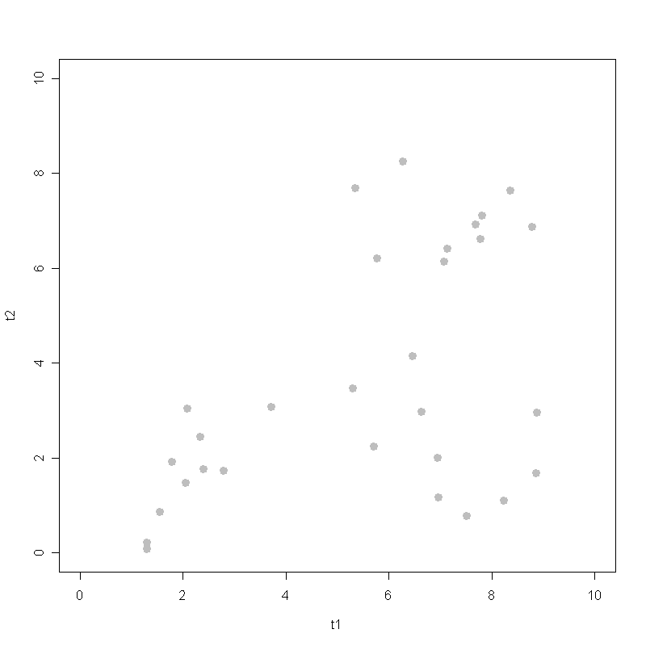
Data points (documents)
Do you see any pattern by looking at the data?
What would you say intuitively are the three major groups (clusters)?

Slide 25
Automatic Clustering?
To be visually intuitive, Euclidean distance is used to compute how similar/close one data point is to another in this lecture.
If a method works properly, it should be able to identify these three clusters.

Slide 26
HAC: Hierarchical Agglomerative Clustering
With SIMULATION

Slide 27
Hierarchical Clustering
Ch. 17
Build a tree-based hierarchical taxonomy (dendrogram) from a set of documents.
One approach: recursive application of a partitional clustering algorithm.
animal
vertebrate
invertebrate
fish reptile amphib. mammal worm insect crustacean

Slide 28
Dendrogram: Hierarchical Clustering
Clustering obtained by cutting the dendrogram at a desired level: each connected component forms a cluster.

Slide 29
Hierarchical Agglomerative Clustering (HAC)
Sec. 17.1
Starts with each doc in a separate cluster
then repeatedly joins the closest pair of clusters, until there is only one cluster (or until it reaches a desired number of clusters).
The history of merging forms a binary tree or hierarchy.

Slide 30
Closest pair of clusters
Sec. 17.2
Many approaches to defining closest pair of clusters
Single-link
Similarity of the most similar between documents in two clusters
Complete-link
Similarity of the “furthest” points, the least similar, among all pairs of documents in two clusters
Centroid (used in this lecture)
Clusters whose centroids (centers of gravity) are the most cosine similar
Average-link
Average similarity between pairs of documents in two clusters
Later simulations in this lecture use Euclidean closeness instead of cosine for inter-cluster similarities

Slide 31
Hierarchical Agglomerative Clustering
1: Let k be the number of clusters desired.
2: Treat all n documents as the initial clusters
3: DO:
4: Merge the closest pair of clusters
5: Use centroid as the new cluster
6: REPEAT 4 - 5 until k clusters left
If we set k=1, then the method will build the entire hierarchy up to the root (all merged into one cluster).

Slide 32
Hierarchical Agglomerative Clustering
Say we are going to find three clusters from data, i.e., k=3
The following slides will show you how hierarchical agglomerative clustering works
In a visual way (hopefully intuitively)
Iteratively (after many steps)
And eventually identifies three clusters
So be sure to run slides on the “Slide Show” mode

Slide 33
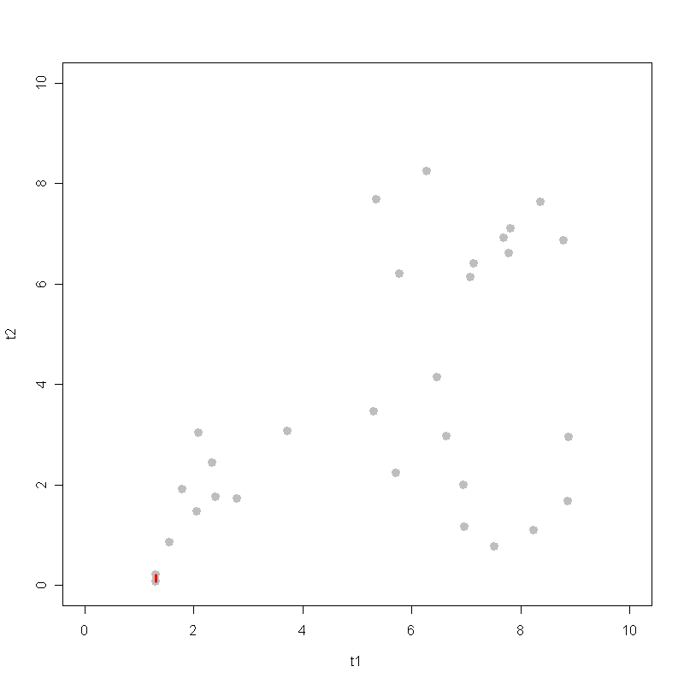
Data
Here are data that we have seen.
myplot 1

Slide 34
Iteration 1
After computing all pair-wise distances, the distance between the two points here is found to be the smallest, i.e., greatest closeness/similarity.
So we first merge the two here into a new cluster, which is then represented by the centroid/center of the two.
myplot 1

Slide 35
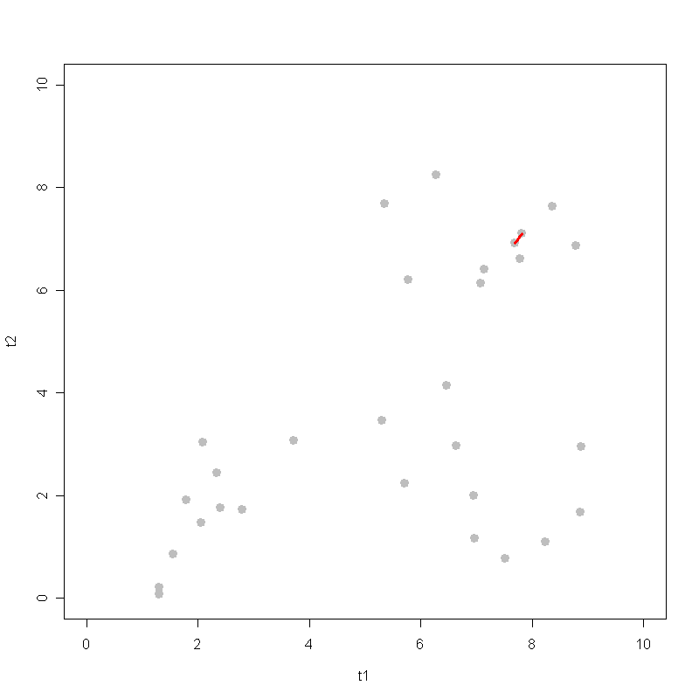
Iteration 2
(2)
Then we continue to find the closest pair and merge them.
After merge, again, use the centroid and treat them as one.
(1)
After the first merge, we treat the two here as ONE.
myplot 2

Slide 36
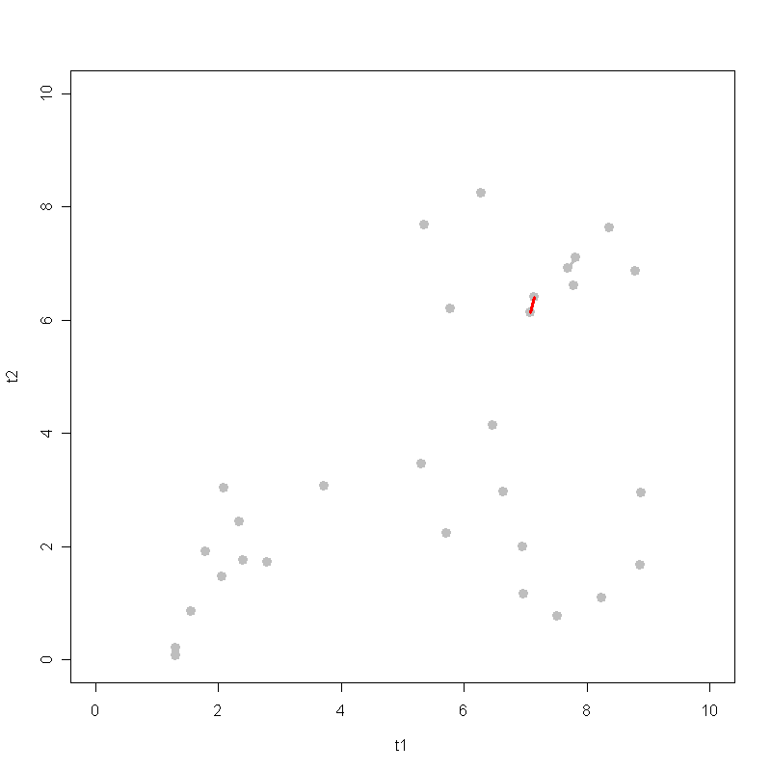
Iteration 3
Continue to find the closest pair and merge them.
And so on…
myplot 3

Slide 37
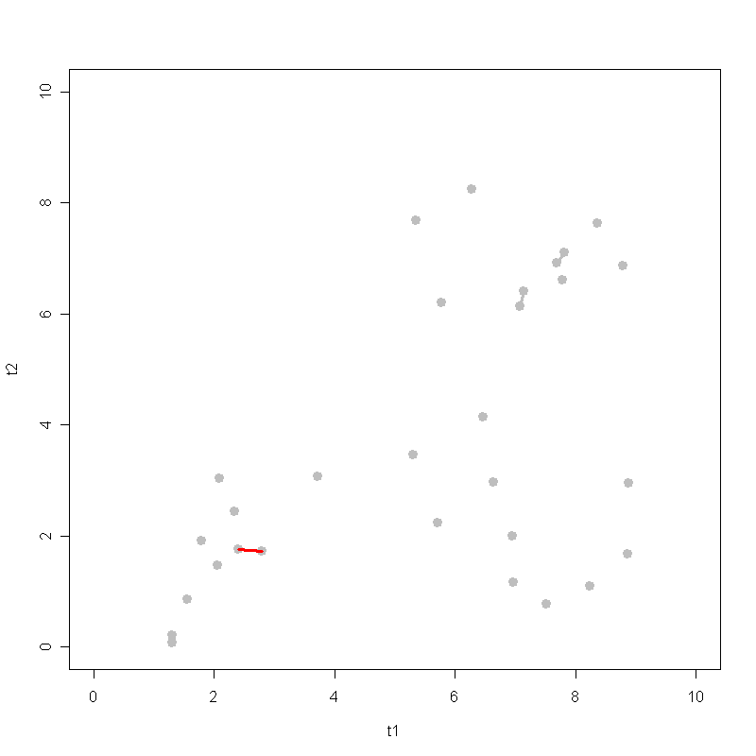
Iteration 4
myplot 4

Slide 38
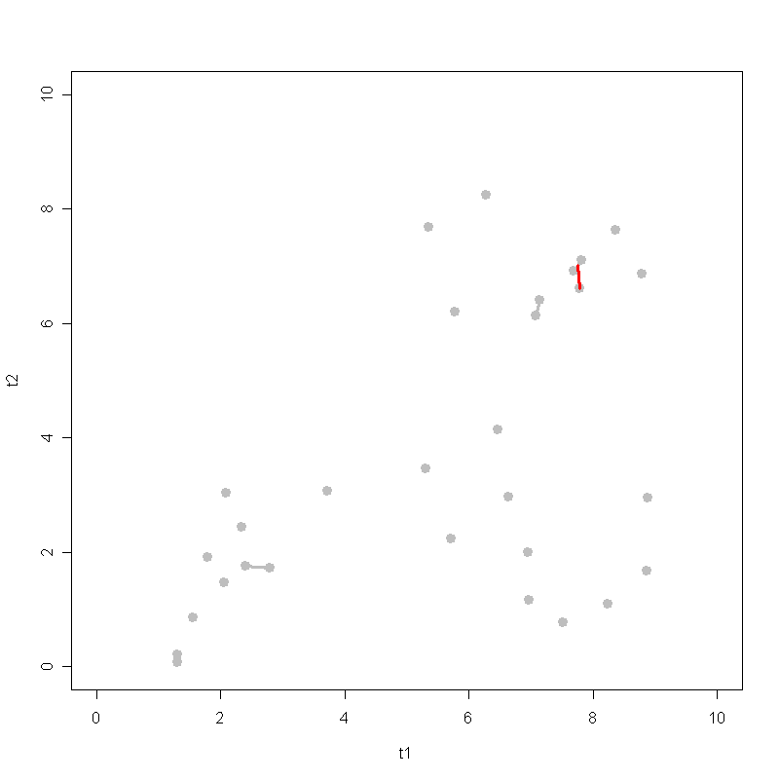
Iteration 5
myplot 5

Slide 39
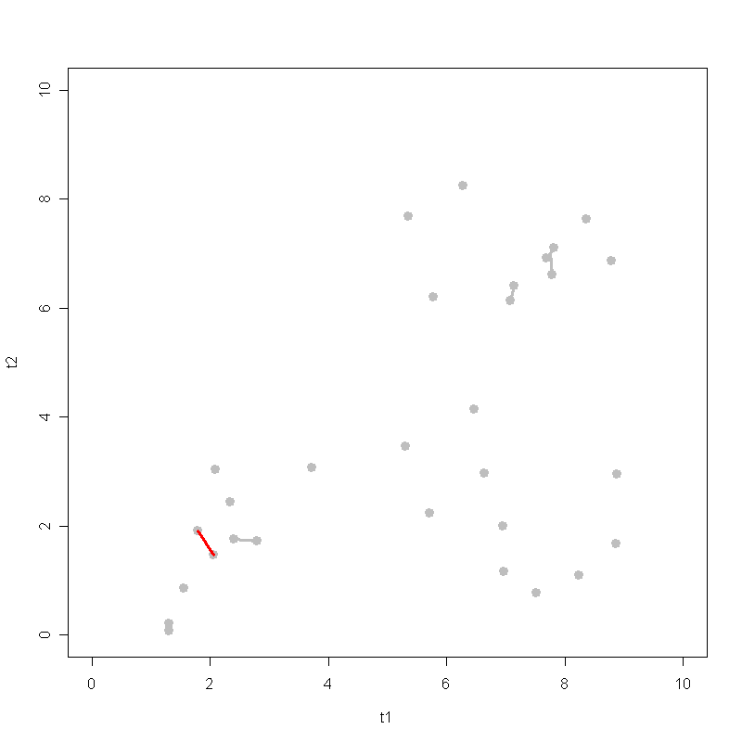
Iteration 6
myplot 6

Slide 40
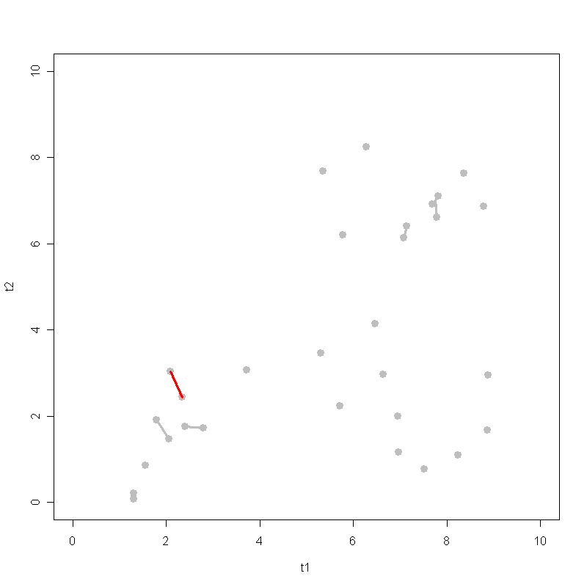
Iteration 7
myplot 7

Slide 41
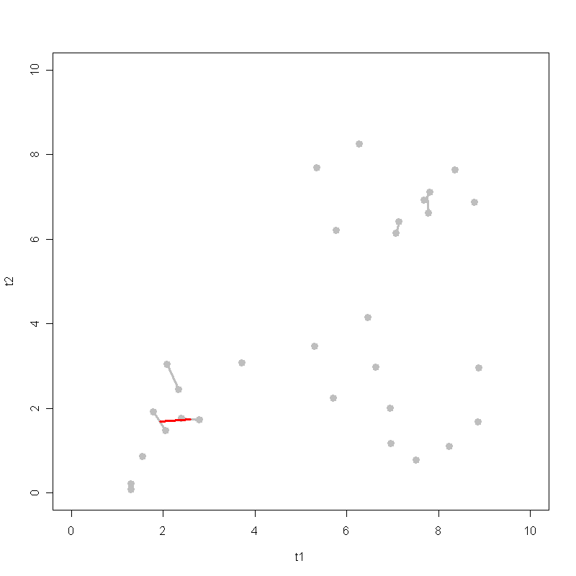
Iteration 8
myplot 8

Slide 42
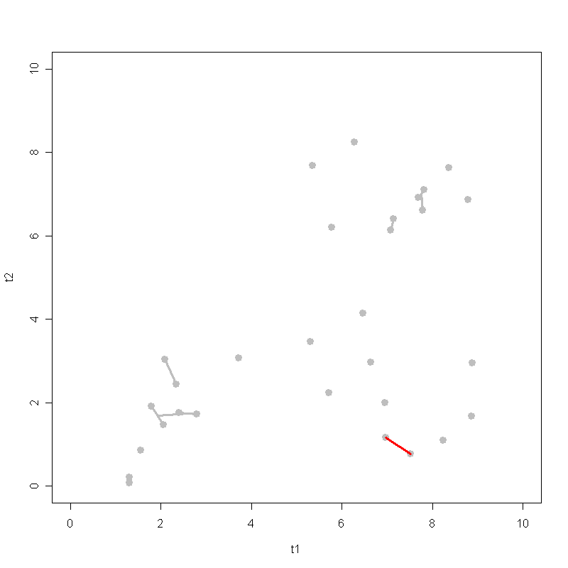
Iteration 9
myplot 9

Slide 43
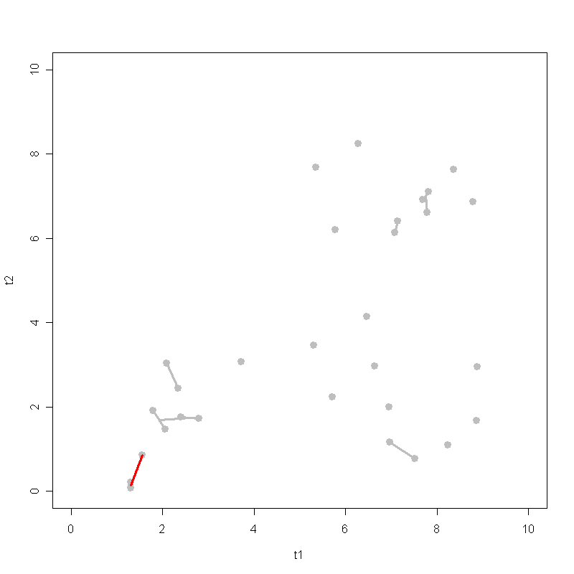
Iteration 10
myplot 10

Slide 44
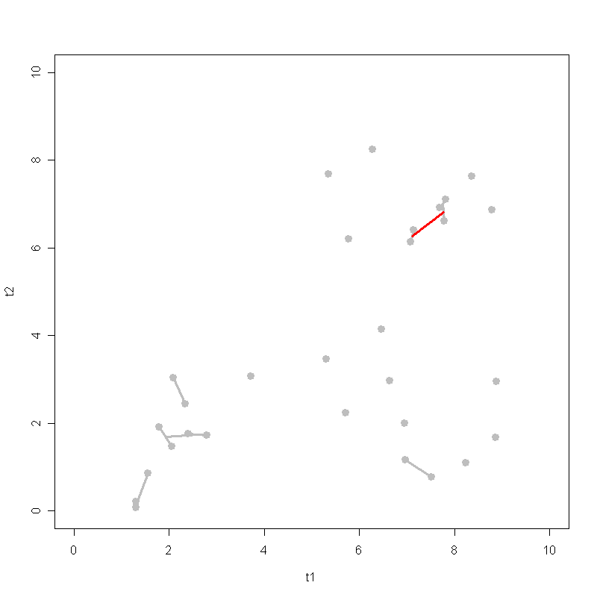
Iteration 11
myplot 11

Slide 45
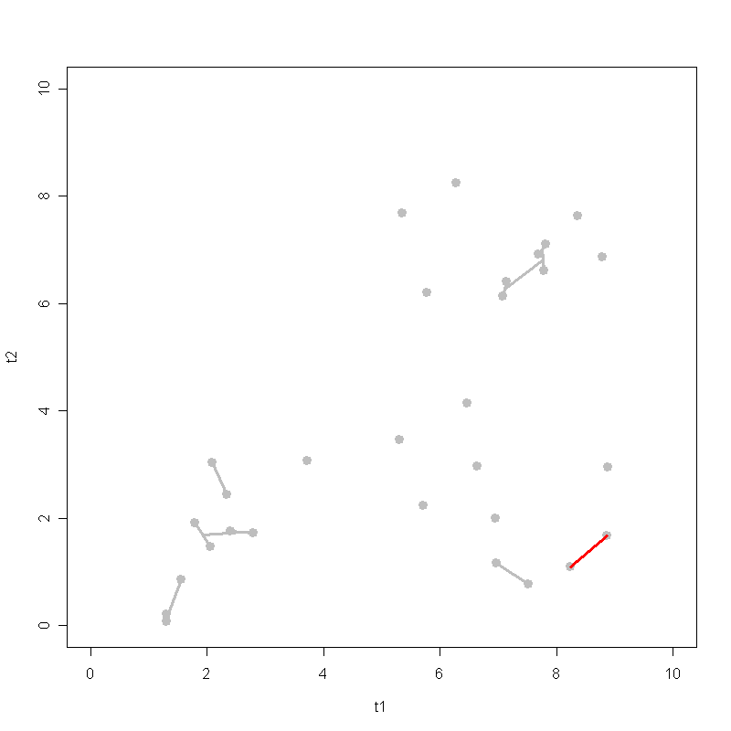
Iteration 12
myplot 12

Slide 46
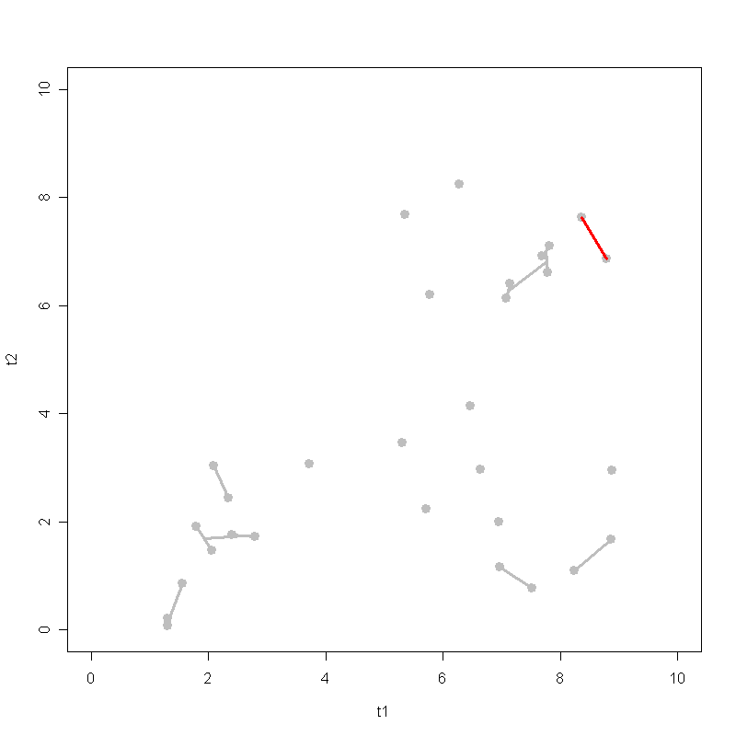
Iteration 13
myplot 13

Slide 47
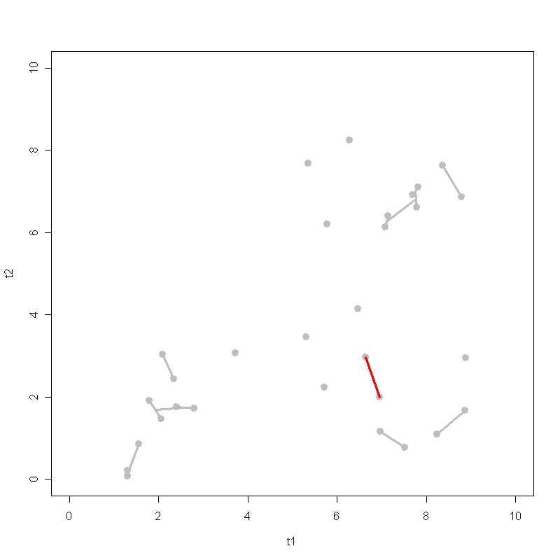
Iteration 14
myplot 14

Slide 48
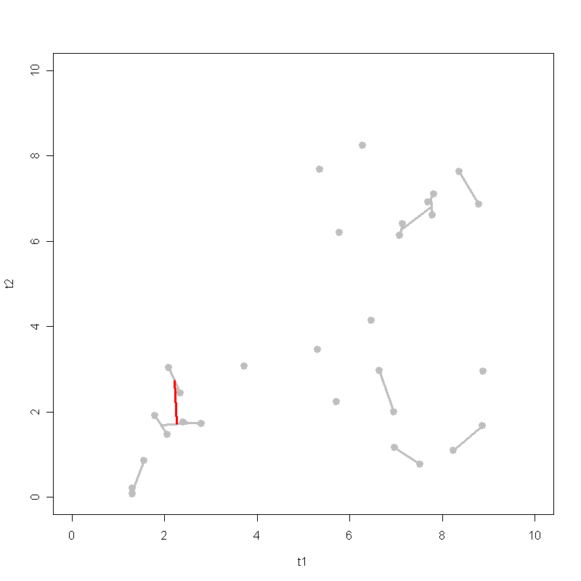
Iteration 15
myplot 15

Slide 49
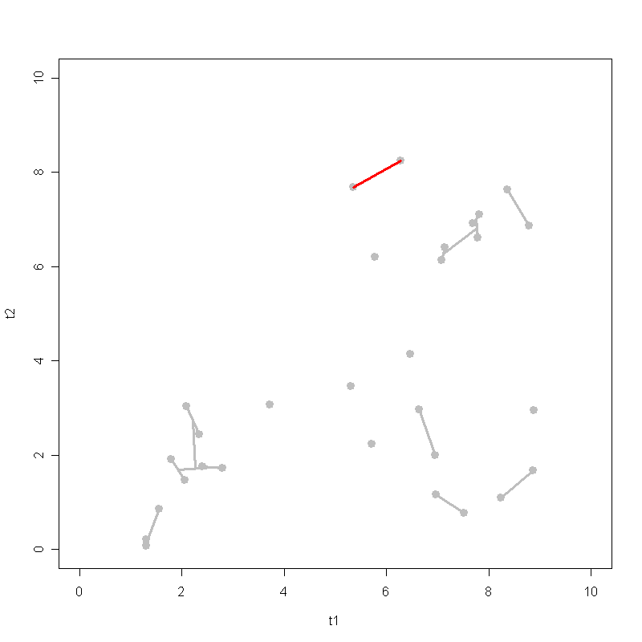
Iteration 16
myplot 16

Slide 50
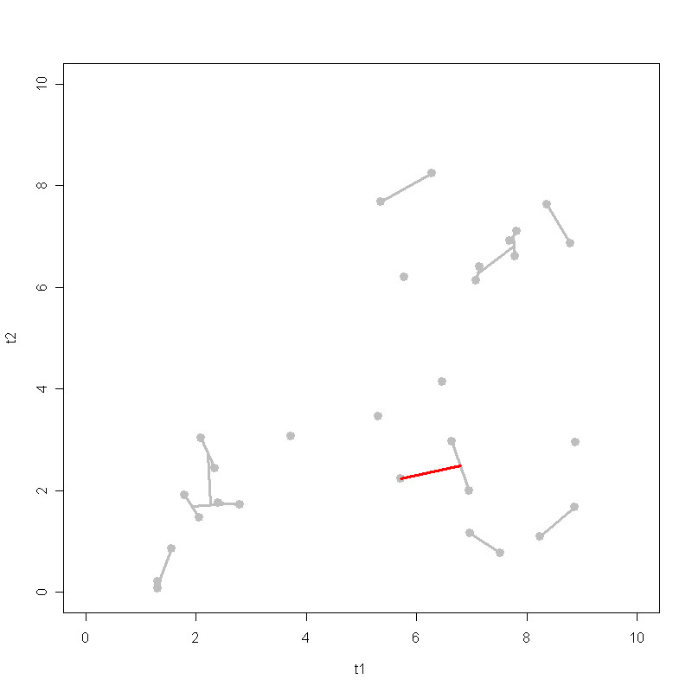
Iteration 17
myplot 17

Slide 51
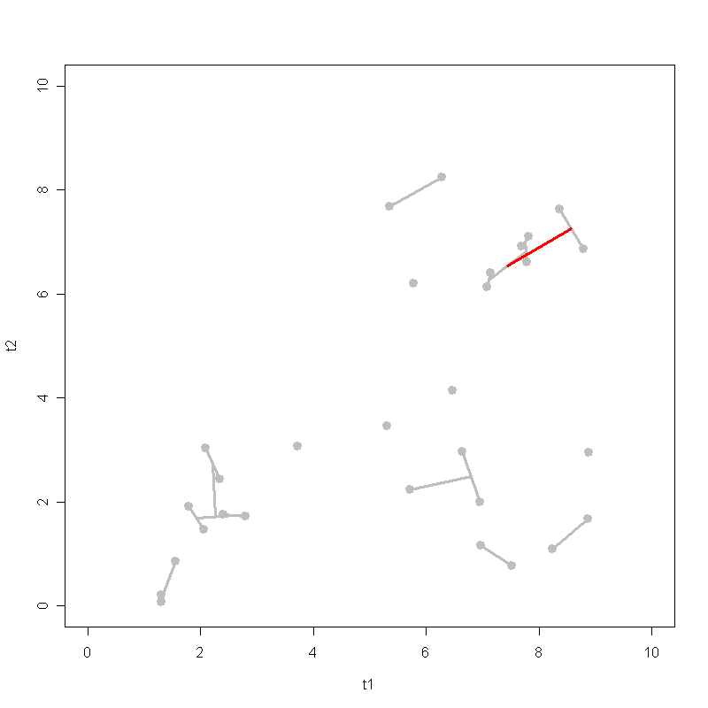
Iteration 18
myplot 18

Slide 52
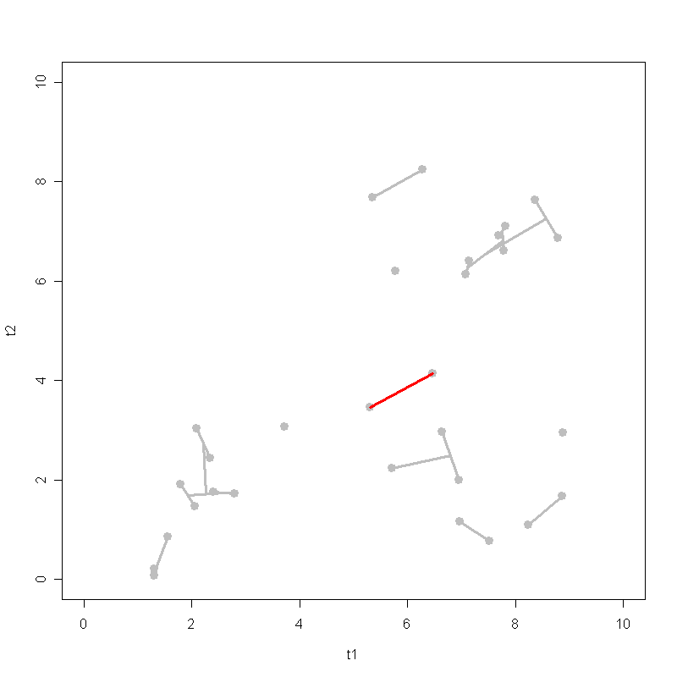
Iteration 19
myplot 19

Slide 53
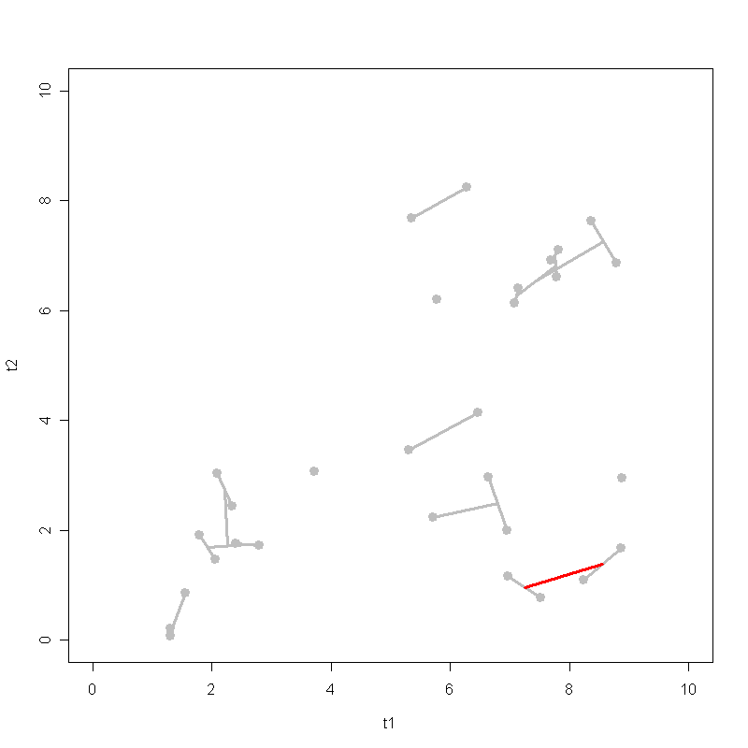
Iteration 20
myplot 20

Slide 54
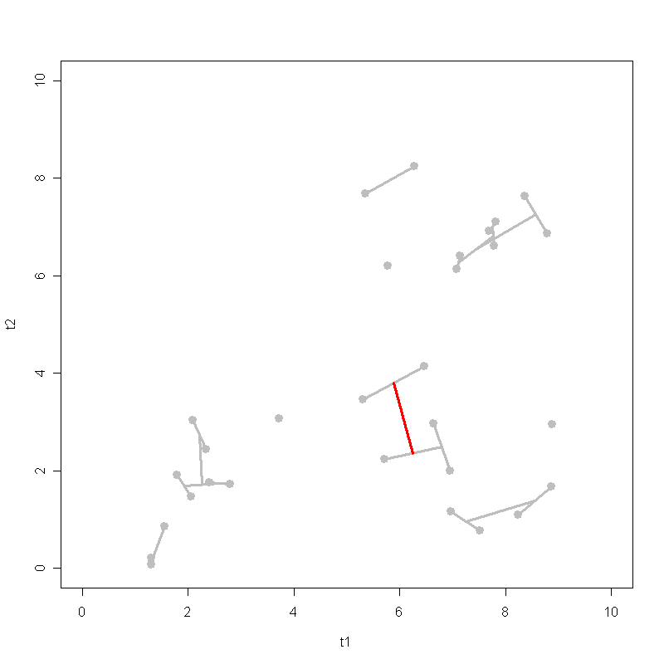
Iteration 21
myplot 21

Slide 55
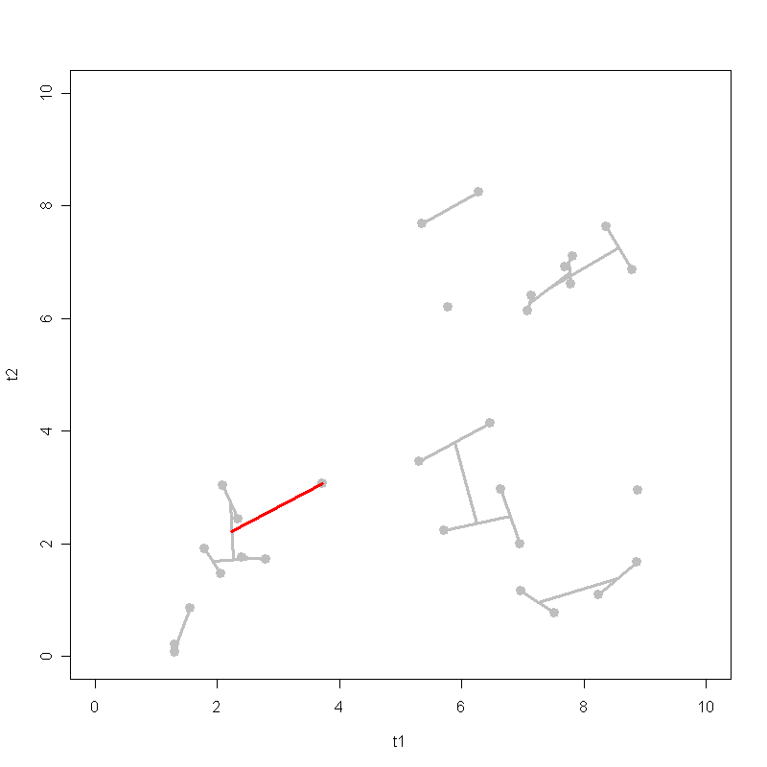
Iteration 22
myplot 22

Slide 56
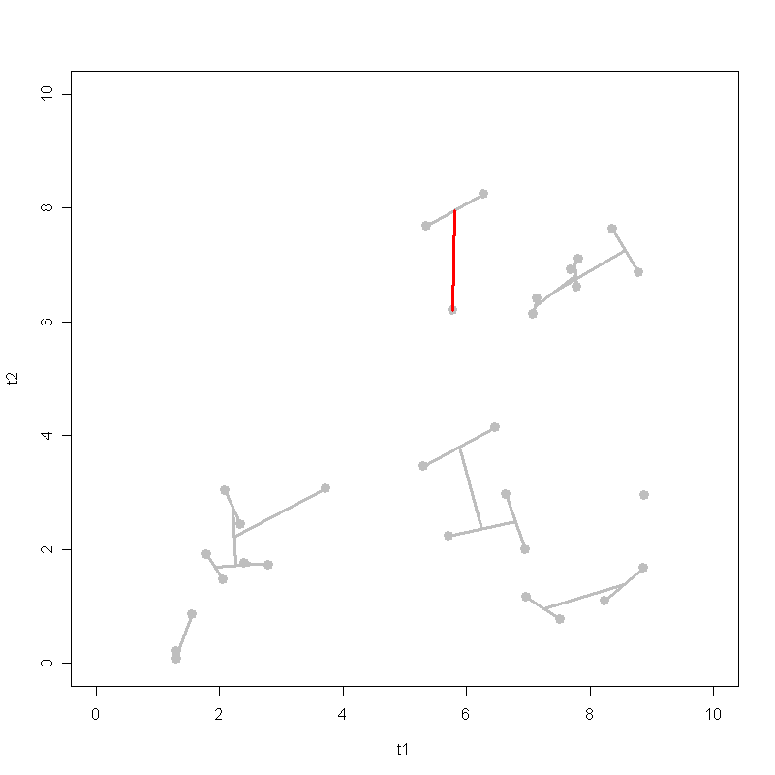
Iteration 23
myplot 23

Slide 57
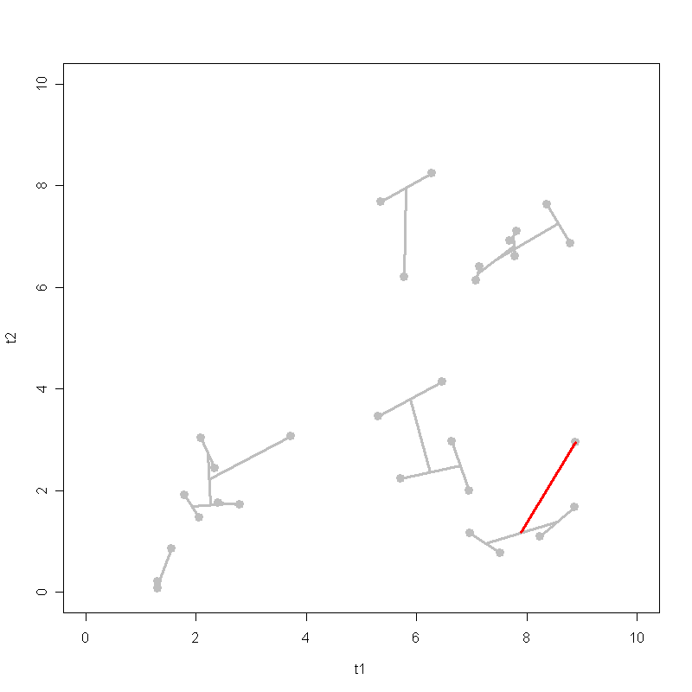
Iteration 24
myplot 24

Slide 58
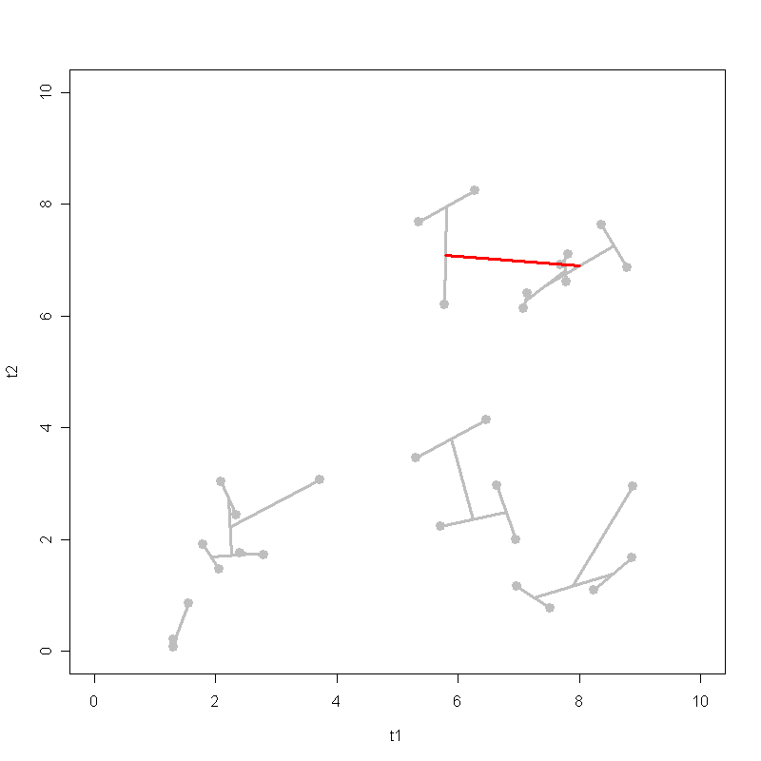
Iteration 25
myplot 25

Slide 59
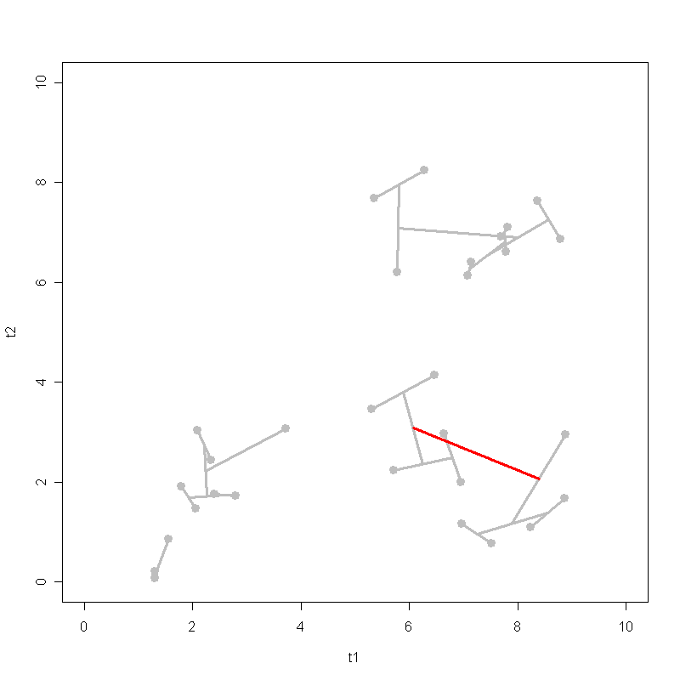
Iteration 26
myplot 26

Slide 60
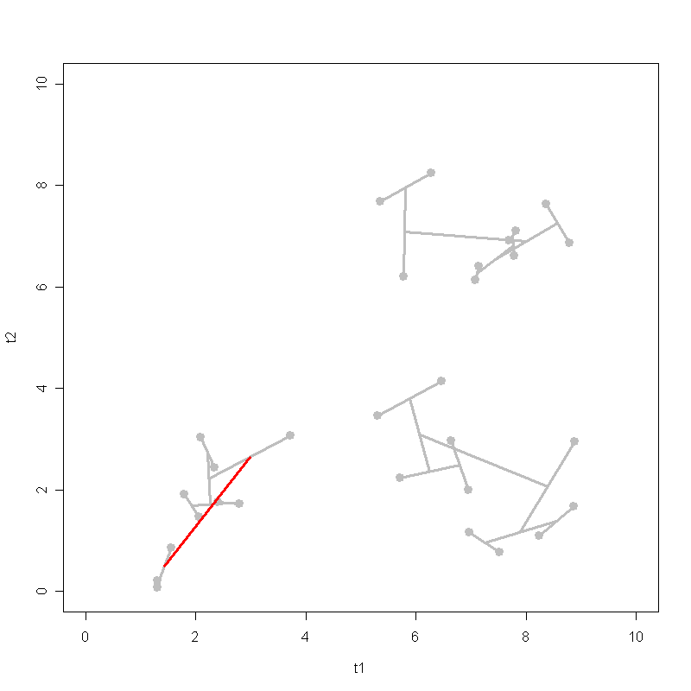
Iteration 27 – DONE
We’ve got THREE clusters here.
myplot 27

Slide 61
Iteration 27 – DONE
myplot 27

Slide 62
Problem of Hierarchical Agglomerative Clustering (HAC)
Computational complexity, n²
For example, given 1000 documents → need to compute 1000 x (1000-1)/2 pair-wise similarities
What if you have 1 million documents?
Need more efficient / scalable algorithms

Slide 63
K-means Clustering
With SIMULATION

Slide 64
K-Means Clustering
1: Let k be the number of clusters desired.
2: Select k points as the initial centroids (e.g., randomly)
3: DO:
4: assign each doc to its closest centroid.
5: re-compute the centroid of each cluster.
6: REPEAT 4 – 5 until the centroids don't change.

Slide 65
Termination conditions
Sec. 16.4
Several possibilities, e.g.,
A fixed number of iterations.
Doc partition unchanged.
Centroid positions don’t change.

Slide 66
K-Means Clustering
Simulation:
Say we want to identify three clusters from data using k-means
i.e., k = 3
The following slides will show you how k-means works

Slide 67
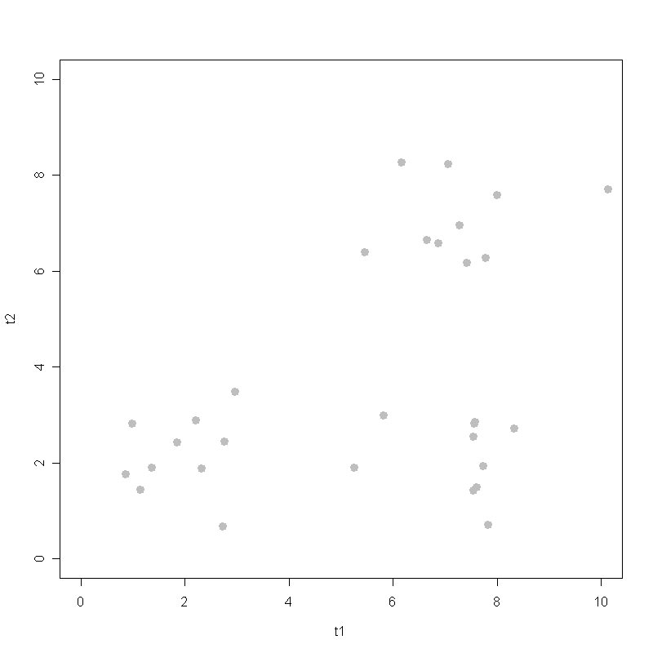
Initial space
Similar data here.

Slide 68
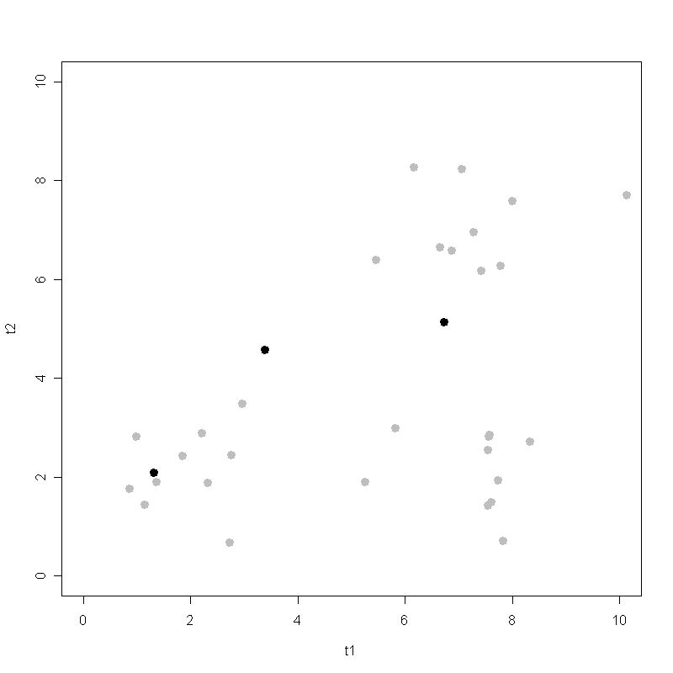
Initial clusters – randomly picked
Randomly pick three points as initial clusters (seed centroids).
As you can see, they are not representative of the actual clusters.

Slide 69
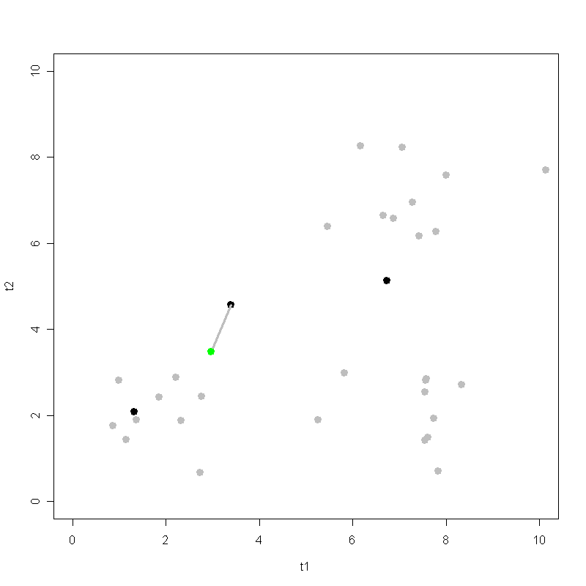
Iteration 1 – 1st assignment
Compare every data point to the three initial clusters and find out which one (of the three) is closest.
Here a data point (document) is assigned/merged to its closest cluster.

Slide 70
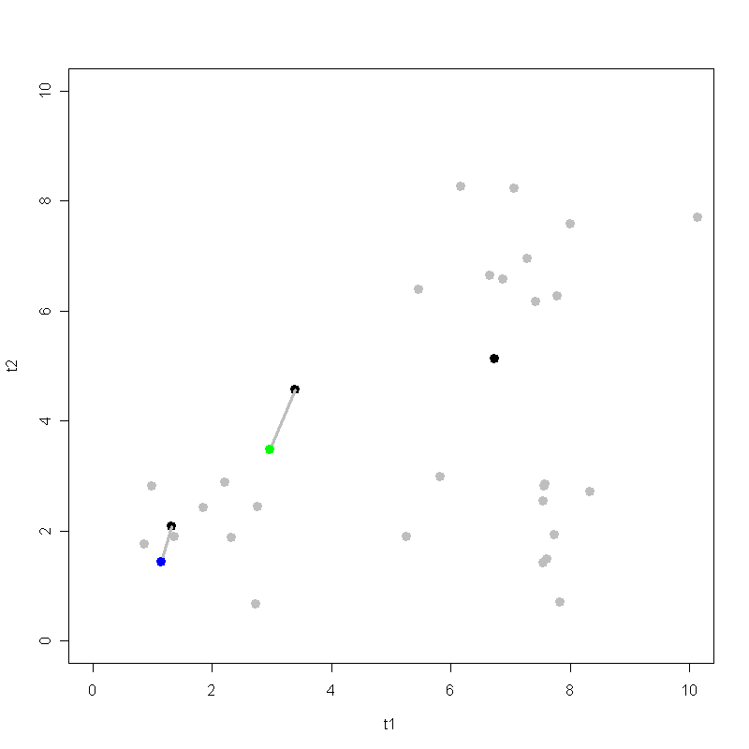
Iteration 1 – 2nd assignment
Another data point (document) is assigned to its closest cluster.

Slide 71
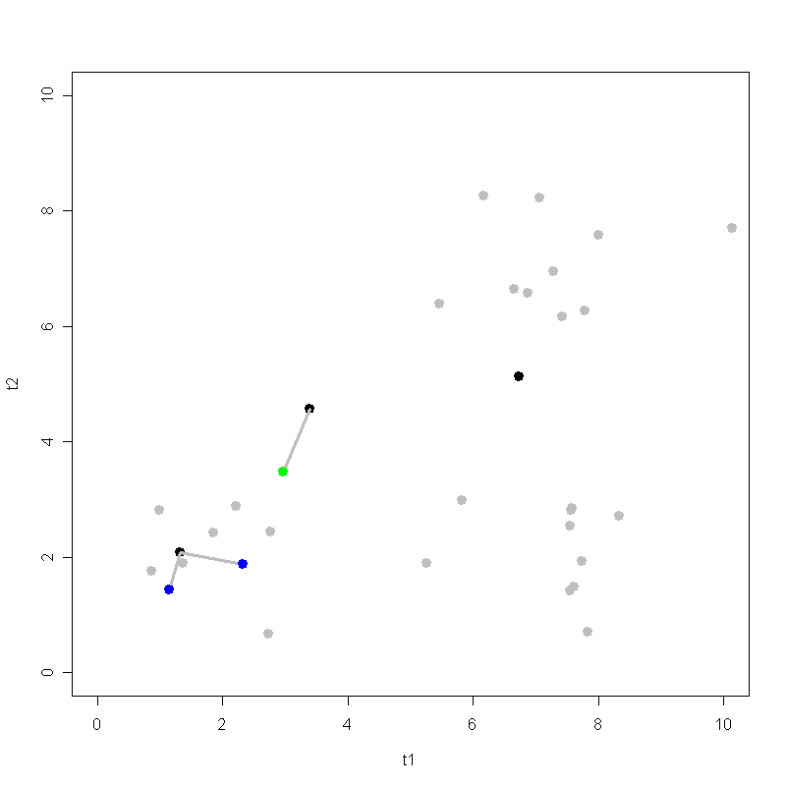
Iteration 1 – 3rd assignment
Yet another data point (document) is assigned to its closest cluster.
And so on….

Slide 72
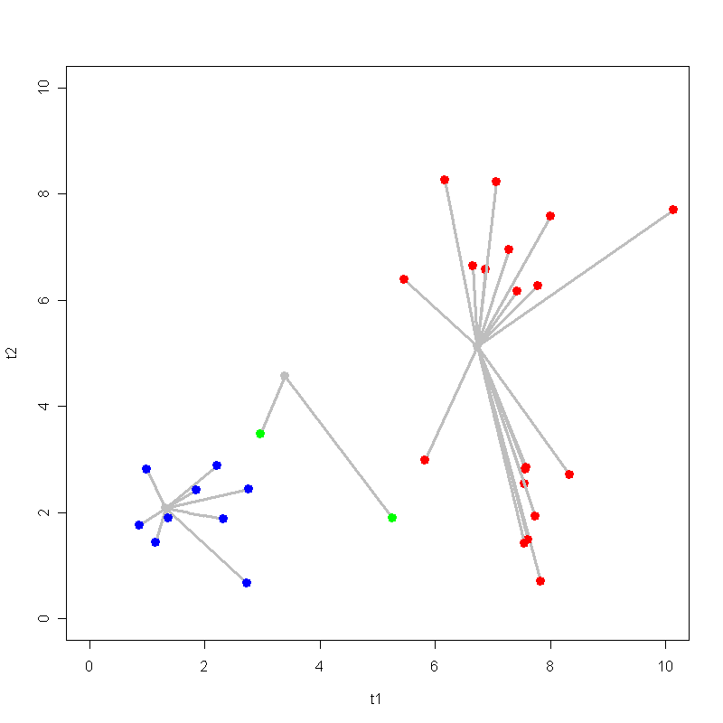
Iteration 1 – all assigned
Iteration 1
After all data points are assigned to their closest clusters…
Are we done? NO.

Slide 73
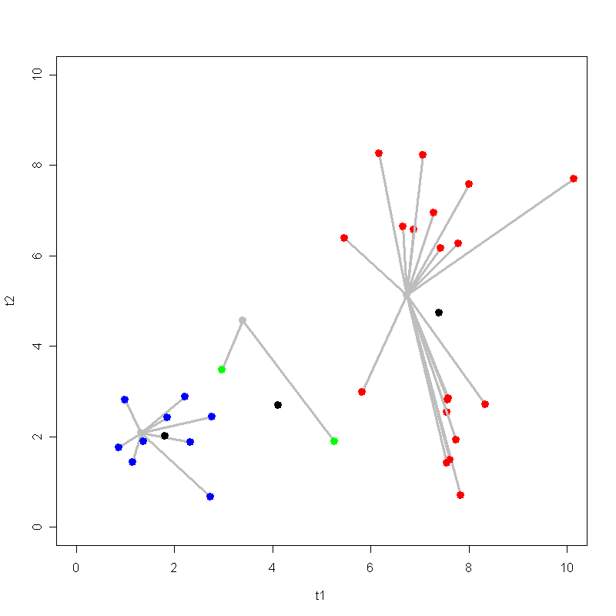
Iteration 1 – recompute centroids
Iteration 1
The clusters don’t look good here.
Re-calculate the centroids/centers of the three clusters based on data points assigned to them.
Now the new centroids of the clusters are different from the initial ones.
They’ve moved.

Slide 74
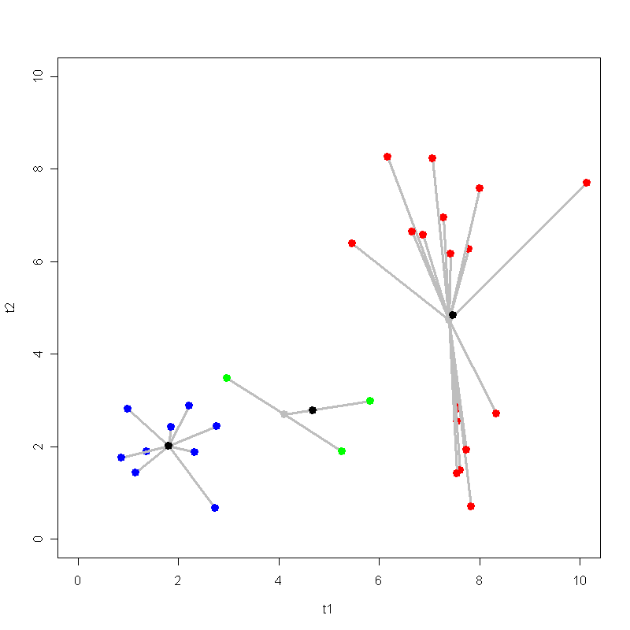
Iteration 2
Iteration 2
Re-assign all data points to their closest new centroids.
And calculate, again, the three new (newer) centroids.

Slide 75
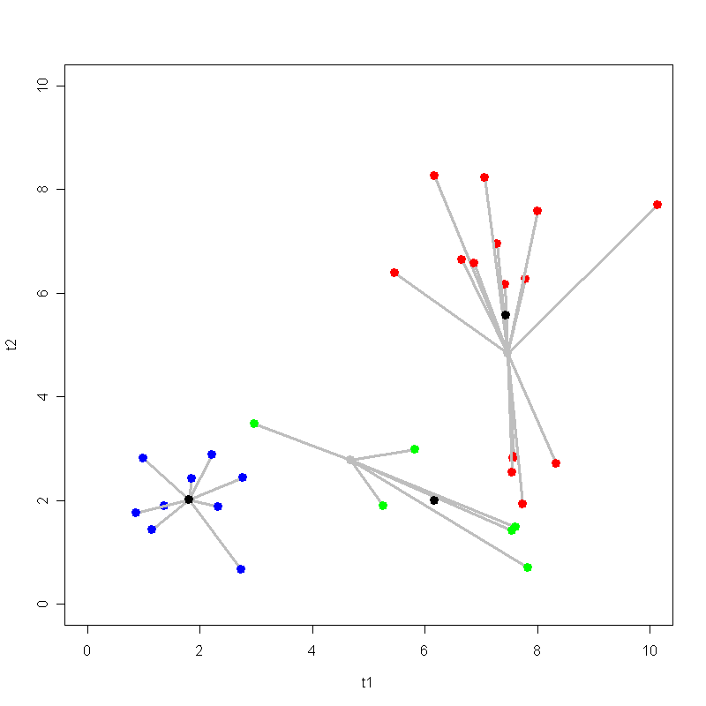
Iteration 3
Iteration 3
Continue…
Re-assign data points to closest centroids and get newer centroids.

Slide 76
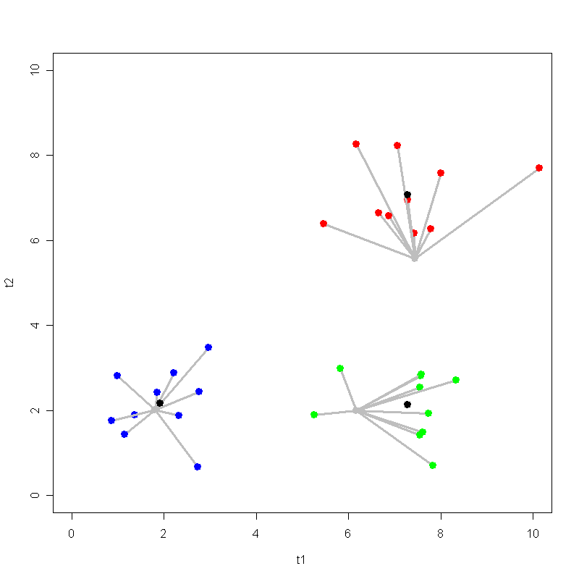
Iteration 4
Iteration 4
And so on…
After each assignment, the centroids move.

Slide 77
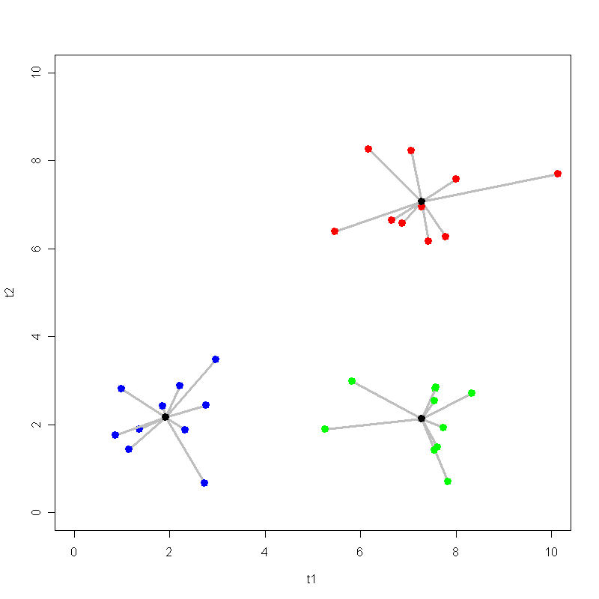
Iteration 5
Iteration 5
Continue... until…??

Slide 78
Iteration 6 – converged
Iteration 6
STOP when the centroids don’t move (change) any more.
Or when there is very little change…

Slide 79
Iteration 6 – converged
Iteration 6
The three clusters DON’T MOVE anymore.

Slide 80
Iteration 6 – converged
Iteration 6

Slide 81
K-means complexity
Computational complexity, kn
For example, given 1000 documents and 3 clusters needed → need to compute 3 x 1000 pair-wise similarities
More scalable than the agglomerative clustering

Slide 82
K-means issues, variations, etc.
Sec. 16.4
Recomputing the centroid after every assignment (rather than after all points are re-assigned) can improve speed of convergence of K-means
Assumes clusters are spherical in vector space
Sensitive to coordinate changes, weighting etc.

Slide 83
K-means: How Many Clusters?
Number of clusters K is given
Partition n docs into predetermined number of clusters
Finding the “right” number of clusters is part of the problem
Given docs, partition into an “appropriate” number of subsets.
e.g., for query results - ideal value of K not known up front - though UI may impose limits.

Slide 84
Clustering Evaluation

Slide 85
What Is A Good Clustering?
Sec. 16.3
Internal criterion: A good clustering will produce high quality clusters in which:
the intra-class (that is, intra-cluster) similarity is high
the inter-class similarity is low
The measured quality of a clustering depends on both the document representation and the similarity measure used

Slide 86
External criteria for clustering quality
Sec. 16.3
Quality measured by its ability to discover some or all of the hidden patterns or latent classes in gold standard data
Assesses a clustering with respect to ground truth … requires labeled data
Assume documents with C gold standard classes, while our clustering algorithms produce K clusters, ω₁, ω₂, …, ω_{K} with n_{i} members.

Slide 87
External Evaluation of Cluster Quality
Sec. 16.3
Simple measure: purity, the ratio between the dominant class in the cluster π_{i} and the size of cluster ω_{i}
Biased because having n clusters maximizes purity
Others are entropy of classes in clusters (or mutual information between classes and clusters)

Slide 88
Purity example
Sec. 16.3
• •
• •
• •
• •
• •
• •
• •
• •
•
Cluster I
Cluster II
Cluster III
Cluster I: Purity = 1/6 (max(5, 1, 0)) = 5/6
Cluster II: Purity = 1/6 (max(1, 4, 1)) = 4/6
Cluster III: Purity = 1/5 (max(2, 0, 3)) = 3/5

Slide 89
Rand Index measures between pair decisions. Here RI = 0.68
Sec. 16.3
Number of points | Same Cluster in clustering | Different Clusters in clustering
Same class in ground truth | 20 | 24
Different classes in ground truth | 20 | 72
TP
FN
FP
TN

Slide 90
Rand index and Cluster F-measure
Sec. 16.3
Compare with standard Precision and Recall:
People also define and use a cluster F-measure, which is probably a better measure.

Slide 91
Final word and resources
In clustering, clusters are inferred from the data without human input (unsupervised learning)
However, in practice, it’s a bit less clear: there are many ways of influencing the outcome of clustering: number of clusters, similarity measure, representation of documents, . . .
Resources
MRS chapter 16 except 16.5
MRS chapter 17.1–17.3

